Slide 1
Module 2
Chapter 1: The Relational Data Model

Slide 2
History of Relational data Model
Relational data model was first introduced in 1970 by a computer scientist and mathematician. Ted Codd.
In this model he gave a simple way of storing data to as well as retrieving data from rows and columns in a table that is this model is all both organizing data into tables with rows and columns.
Relational data model uses the concept of mathematical relation and theoretically it is based on set theory.
The first commercial implementations of the relational model was by Oracle DBMS and even IBM started to implement the same. SQL/DS System is IBMs first commercial relational database management system.
Current popular RDBMS are the SQL server and access from Microsoft ,DB2 and Informix from IBM etc. SQL query language became the standard language for these commercial RDBMS.

Slide 3
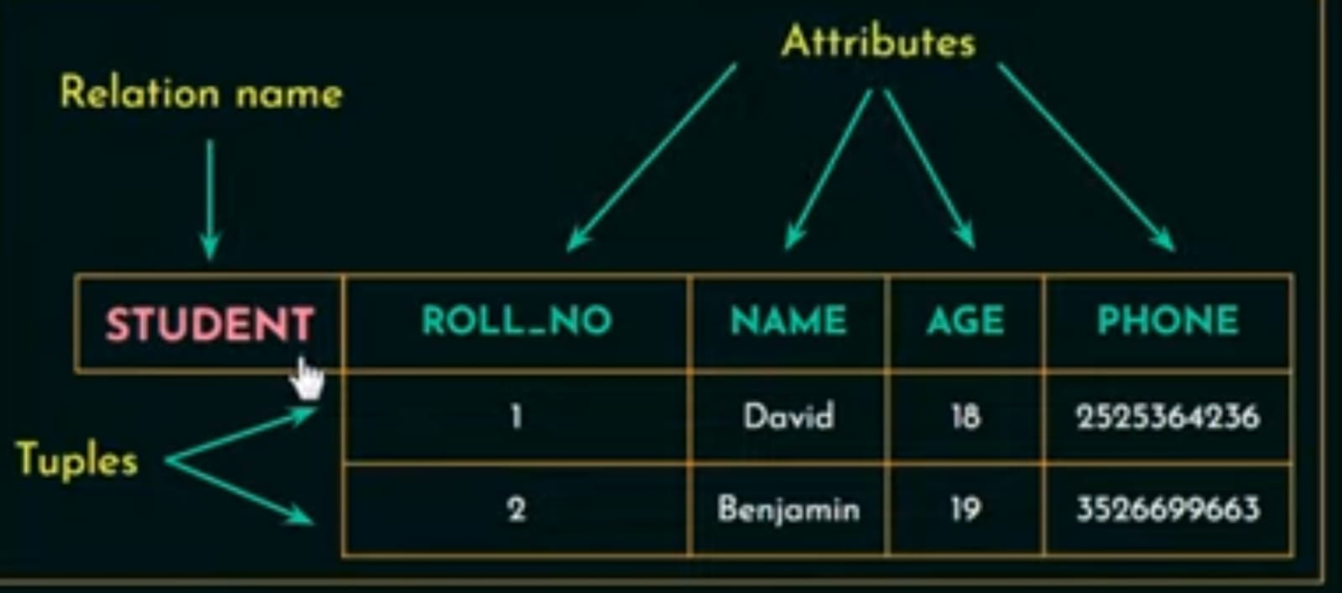
Relational Model Concepts
Relational database model organizes the data in the form of tables or in other words relational model represents data as a collection of tables.
In RDBMS a table is also called a relation.

Slide 4
Here STUDENT is a Relation name or a table name.
Each row are called tuple.
Here we have two tuples or two rows.
Each column or column header are called as attributes or fields.
In this relation student we have four attributes of four columns.

Slide 5
Domain
Domain in mathematics is a set of possible values that you can input.
In Relational database it is a set of atomic values that are allowed for an attribute.
Atomic: Each values in that domain is not divisible further.
Ex: 1) Name : String of characters that represent name of a person.
A set of values to the attribute name should be a string of characters that represent the name of person.
2) Employee_ages: Possible ages of employees of a company (Values between 20 and 70 years old).
Domine not only gives set of values that are allowed for a attributes it also specifies the data type allowed.
Ex: Age has to be a positive integer.

Slide 6
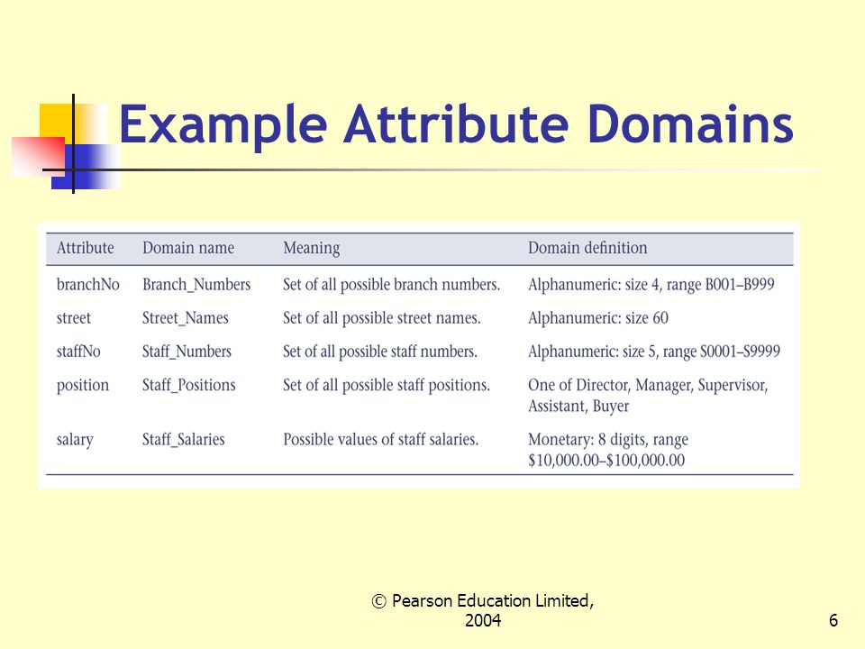

Slide 7
Attribute
Represents a property or characteristic of an entity. Corresponds to a column in a database table.
Examples: EmployeeID, Name, DateOfBirth, Salary.
Domain
Defines the set of possible values that an attribute can take. Essentially, it specifies the data type and constraints for an attribute.
Examples: The domain of EmployeeID might be a set of positive integers.
The domain of DateOfBirth might be a set of valid dates. The domain of Salary might be a set of valid numbers

Slide 8

Relation schema
Relation schema is used to describes a relation or a table.
A relation schema is made up of a relation name R and a list of attributes A1 ,A2 ,A3,………….,An.
Relation schema can also be written, by including the data types.

Slide 9
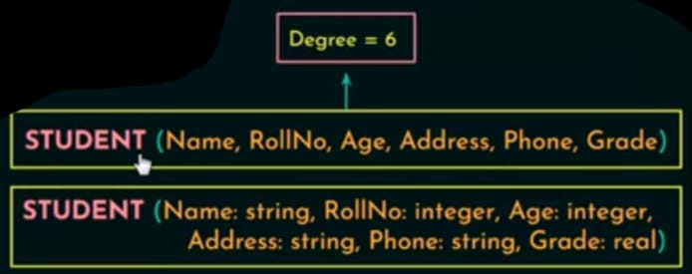
Degree ( or arity) of a Relation
It is defined as a number of attributes in a relation schema.

Slide 10
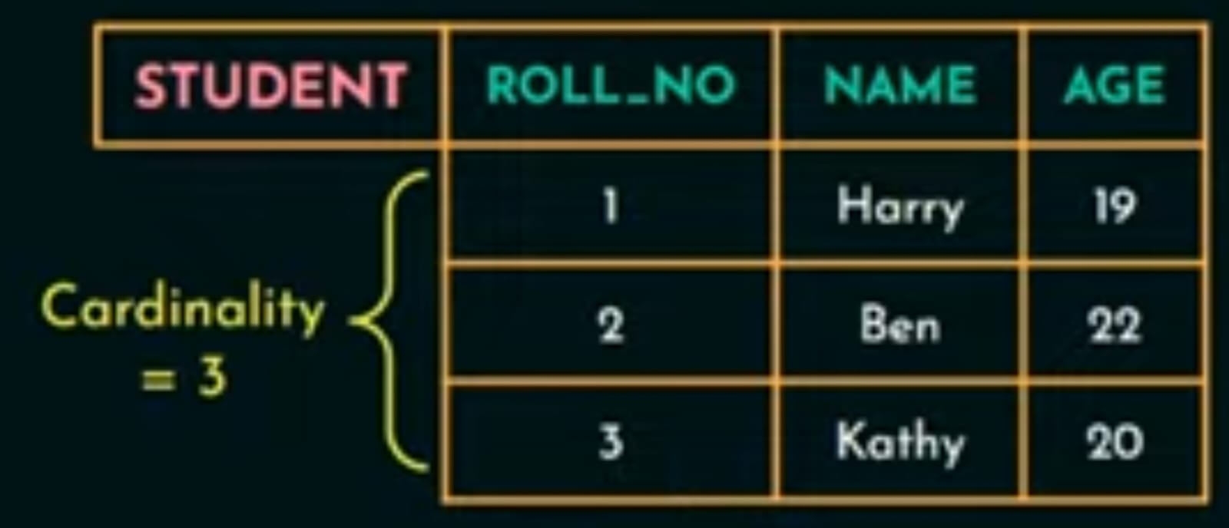
Cardinality
Total number of tuples or rows present in a relation.
Relation state (or relation database instance)
Relation state is a set of tuples at a given time

Slide 11
Relational database schema
It is a set of relation schemas and a set of integrity constraints.
If I consider Company database the relational database schema of that company would have the collection of relation schemas like employee relational schema like employee details the department relation schema the project relational schema etc.
Collection of all these relational schema with all the integrity constraints make up the relational database schema for a company database.

Slide 12
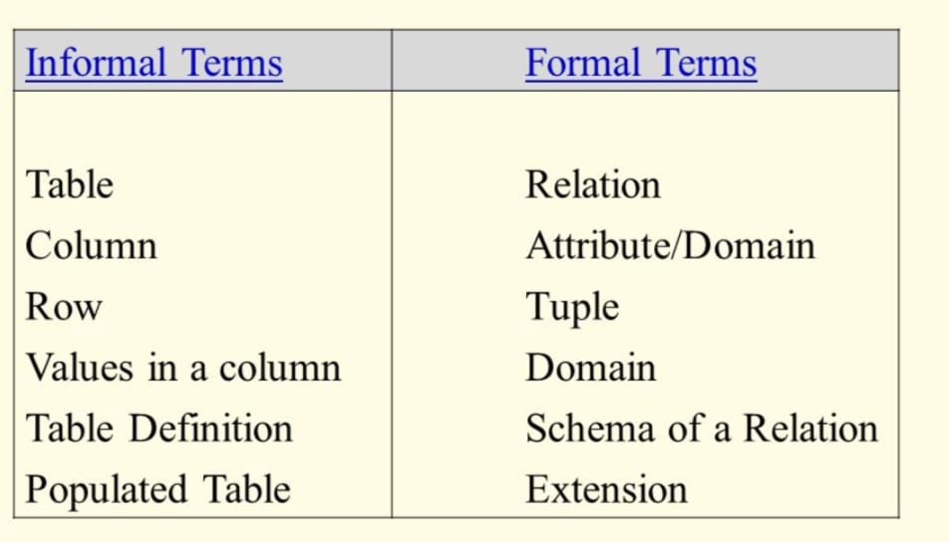

Slide 13
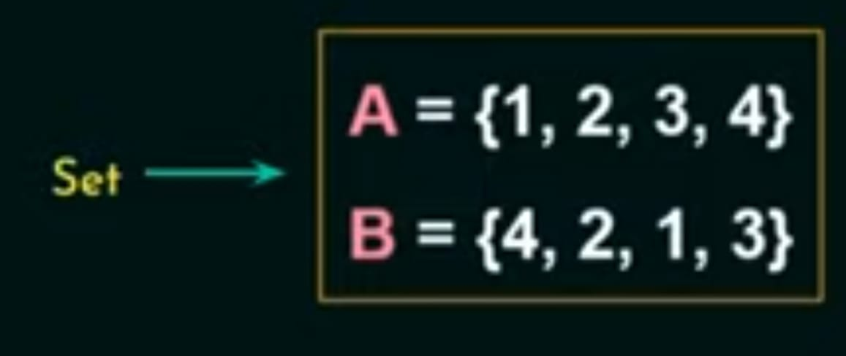
Characteristics of relations
Ordering of tuples within a Relation
A relation or a table is a set of tuples or rows.
Mathematically the elements in a set don’t follow any order and theoretically relational databases were based on set theory. Therefore elements in the set need not fallow any order.

Slide 14
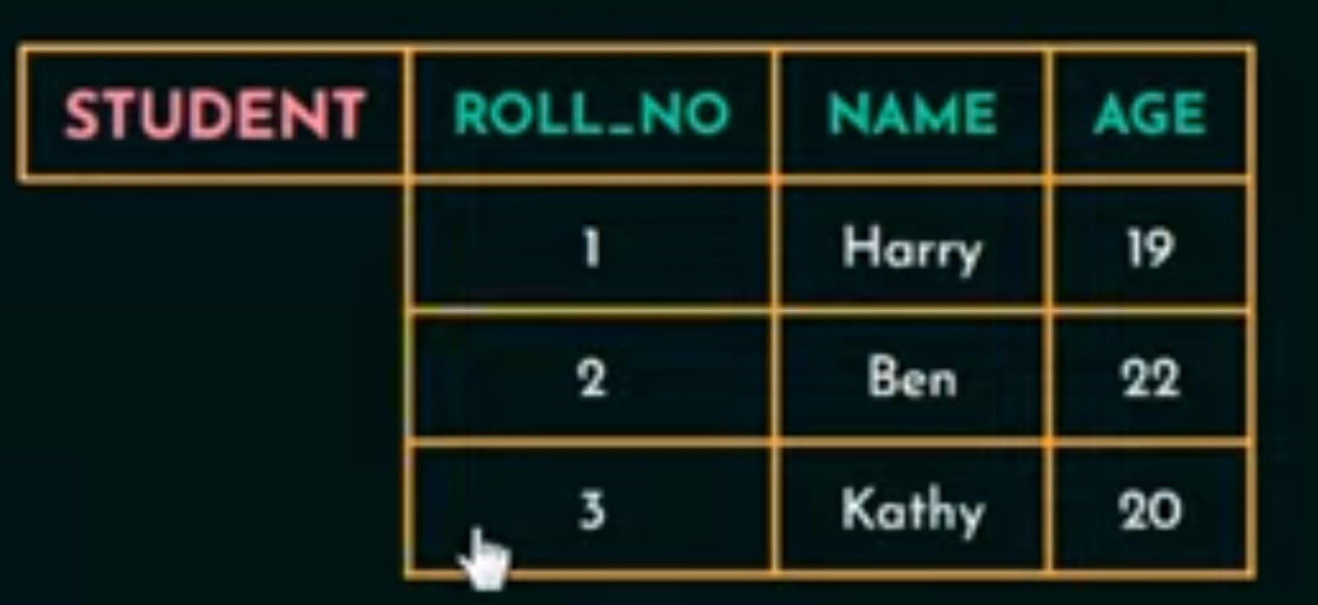
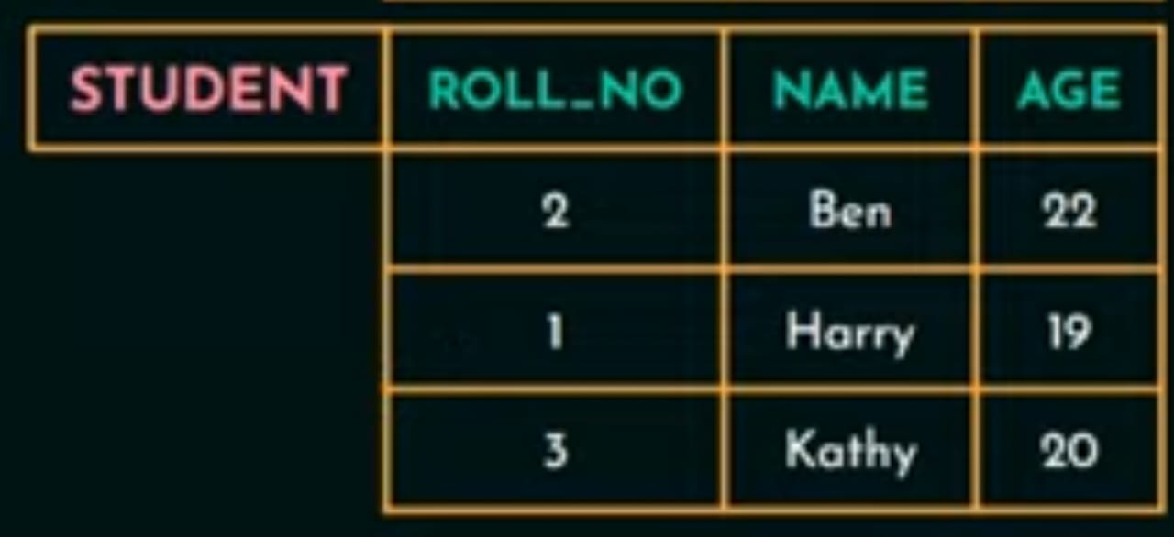
The tuples in a relation need not have any particular order.

Slide 15
But when it comes to files all the records are physically stored on disk or in the memory and since its physically stored it would be good to have an order among the record like first record second record so on. This help in searching and retrieving records faster.

Slide 16
Ordering of values within a Tuple
An n-tuple is an ordered list of n values, so ordering of values in a tuple is important.

Slide 17
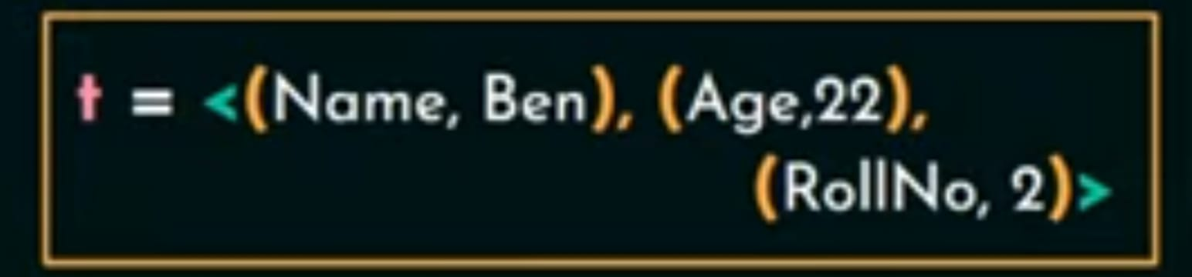
With an alternative definition of relation, ordering of values in a tuple is unnecessary.
A tuple is defined as a set of (<attributes>,<values>) pair, then ordering of attribute is not important because the attribute name and the corresponding values is mention together .

Slide 18
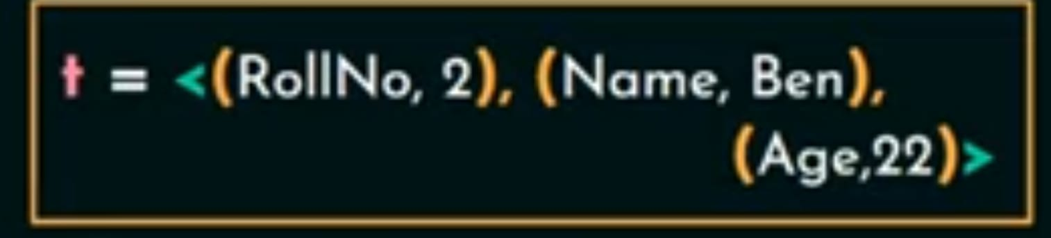
Even if we will change the order of these pairs as given over here the meaning will not change.
But in RDBMS we use relation or table to store the data ordering of values within a tuple is important.

Slide 19
Values and Null in Tuple
Each value in tuple is a atomic value(that is it has to be a value that cannot be divided further).
Since the values has to be atomic we cannot have composite or multivalued attribute in RDBMS and because of that it is called as flat relation model.

Slide 20


In RDBMS or in relational databases these multivalued attribute should be represented by separate relations or separate tables .

Slide 21
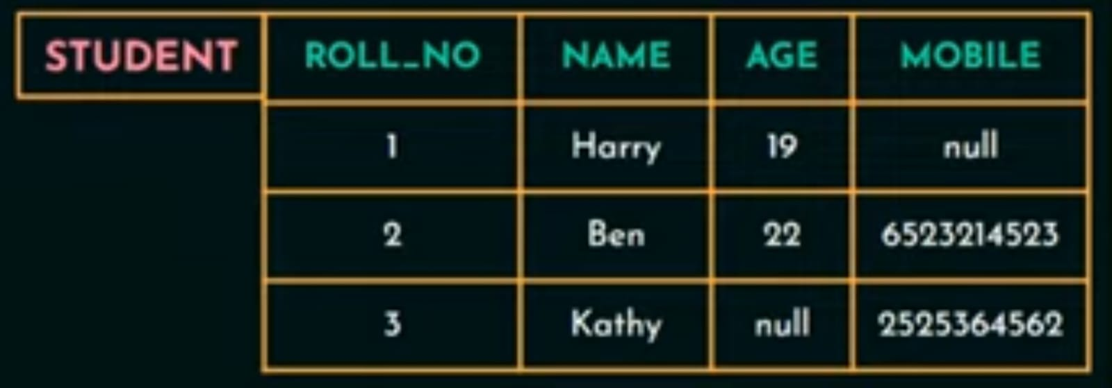
Null values can be used when the values are unknow or when the value exists but it is not available or when the value is not applicable to that particular tuple.

Slide 22

Interpretation of a relation
The Relation schema can be represented as a declaration or assertion.
These relation schema declares or asserts that each student entity has a roll number, name ,age and a mobile number.

Slide 23
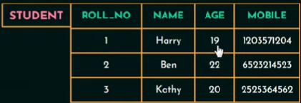
Each tuple in relation trying to declare something about the student and each tuple can be interpreted as a fact .
for example the first tuple in the relation student declares a fact that a student named harry whose roll number is 1 age is 19.
Relation represent facts about entities and relationship.

Slide 24
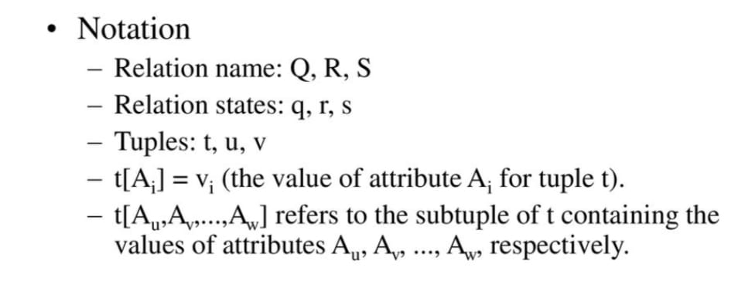

Slide 25
Relational Model Notation
Relation schema R of degree n is denoted by by R(A1, A2, ...,An)
Uppercase letters Q, R, S denote relation names
Lowercase letters q, r, s denote relation states
Letters t, u, v dénote tuples
In general, the name of a relation schema such as STUDENT also indicates the current set of tuples in that relation
An attribute A can be qualified with the relation name R to which it belongs by using the dot notation R.A for example, STUDENT.Name or STUDENT.Age.

Slide 26
Relational Model Notation
An n-tuple t in a relation r(R) is denoted by t = <v1, v2, ..., vn>, where vi is the value corresponding to attribute Ai. The following notation refers to component values of tuples:
Both t[Ai] and t.Ai (and sometimes t[i]) refer to the value vi in t for attribute Ai.
Both t[Au, Aw, ..., Az] and t.(Au, Aw, ..., Az), where Au, Aw, ..., Az is a list of attributes from R,
refer to the sub tuple of values <vu, vw, ..., vz> from t corresponding to the attributes specified in the list.

Slide 27
Relational Model Constraints
Constraints are restrictions on the actual values in a database state.
Constraints on databases can generally be divided into three main categories:
Inherent model-based constraints or implicit constraints
Constraints that are inherent in the data model.(this constraint are inherent or already exits in the data model.)
For example, the constraint that a relation cannot have duplicate tuples is an inherent constraint.

Slide 28
2. Schema-based constraints or explicit constraints
Defined directly in the schemas of the data model.
Ex: Age of the employee has to be between 22 to 65 years. here age is restricted to be between 22 to 65.
The schema-based constraints include domain constraints, key constraints, constraints on NULLs, entity integrity constraints, and referential integrity constraints.
3. Application-based or semantic constraints or business rules
Cannot be directly defined in the schemas of the data model,(that’s why it is difficult to express within the data model)
Hence must be expressed and enforced by the application programs.

Slide 29
Schema-Based Constraints
1) Domain Constraints
Domain Constraints specifies that within each tuple the value of each attribute has to be atomic or indivisible.
This constraint checks the data type of the values of each attribute .
Ex: If we are assigning the data type of the attribute age as int then we cant have any values in that column other than int data type.

Slide 30
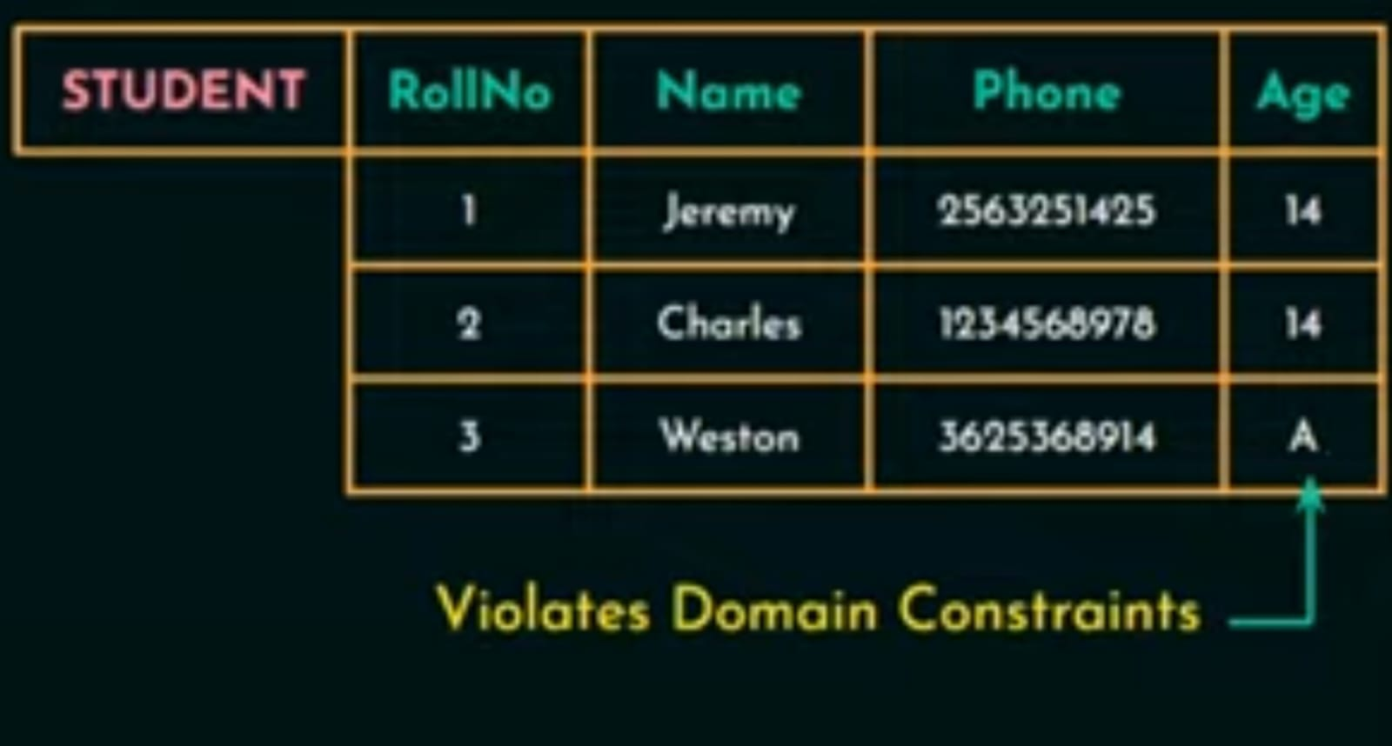

Slide 31
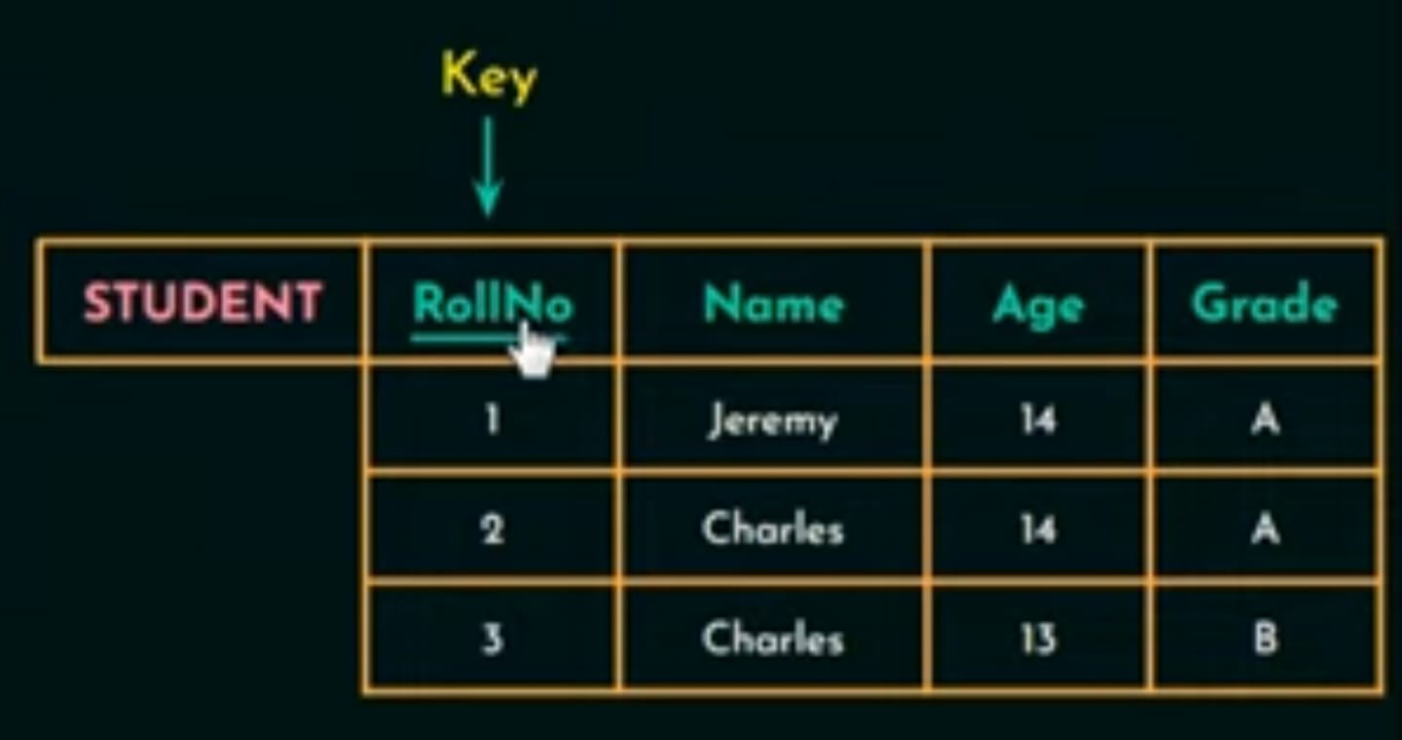
2) Key Constraints
An attribute that can uniquely identify each tuple in a relation is called a Key.

Slide 32

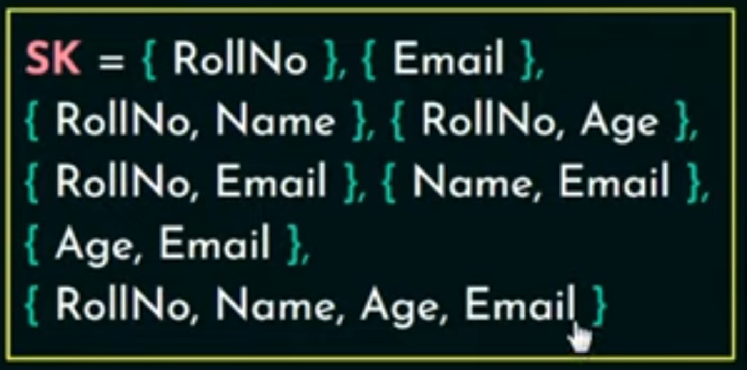
A Super key is set of attribute that can be is identified each tuple in relation uniquely.
A super key specifies that no two tuples can have the same values.
Every relation has at least one super key by default and that super key is a set of all attributes.

Slide 33
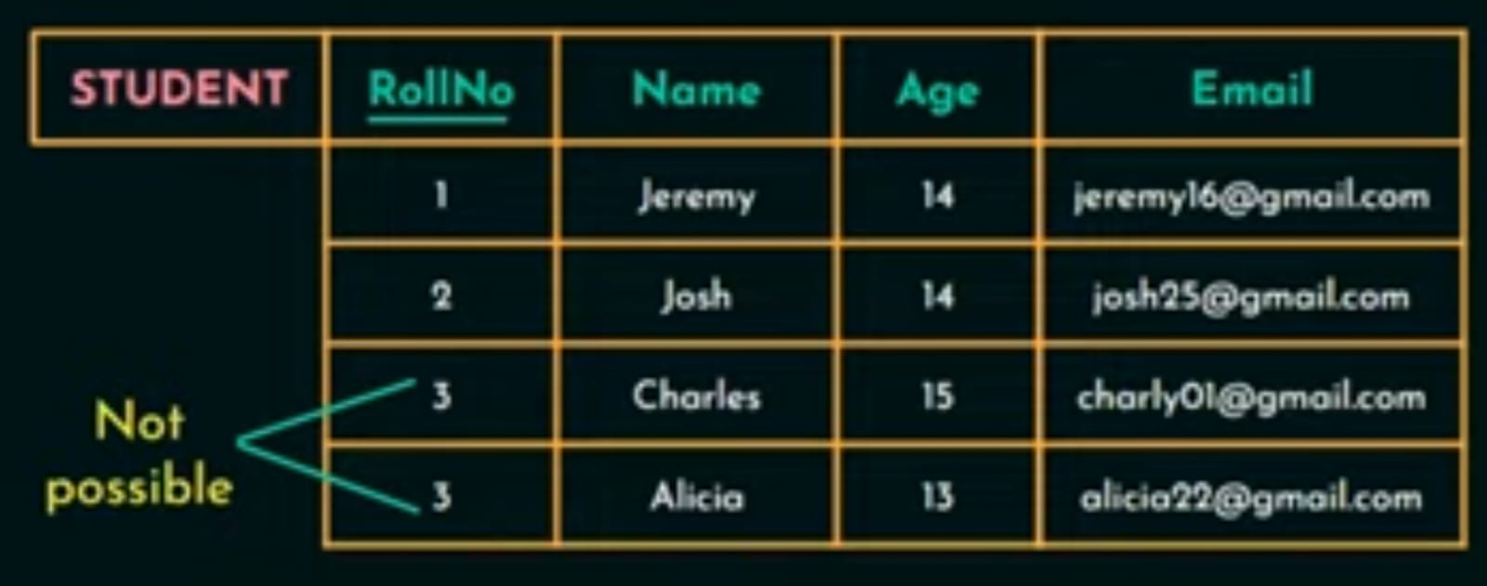
A key satisfies 2 constraints.
Two tuples cannot have identical values for all the attributers in the key.
It has to be a minimum super key
First condition is for both key and super key and second condition is only for keys.

Slide 34
Now the relation schema can have more then one key in that case each of key is called candidate key.
Candidate Key: It is a set of attributes that uniquely identify the tuples in a relation.
Ex: In this relation we have 2 candidate key
roll number.
email.
We can have any number of candidate key in the relation but we designate only one of the candidate key as the primary key of that relation.

Slide 35

3) Constraint on Null values:
Specifies whether null values are permitted or not(NOT NULL).
If we are giving NOT NULL constraint to any of the attribute then value of that attribute cannot be null.
4) Entity Integrity Constraint:
States that no primary key value can be null.

Slide 36
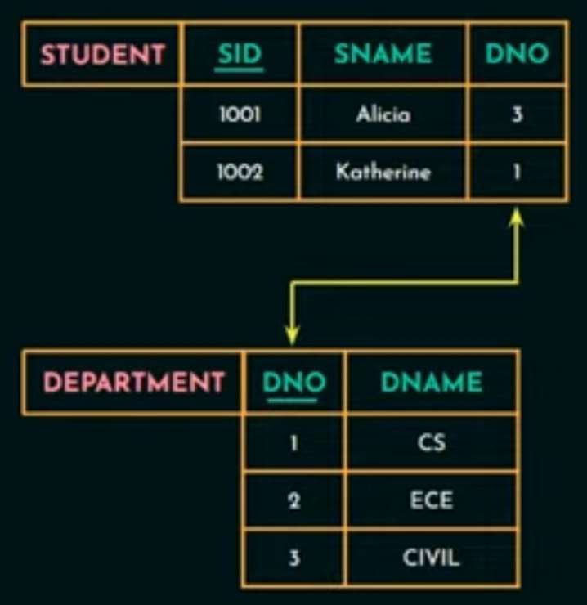
5) Referential integrity Constraint
A key constraint and entity integrity constraint are specified on a single relation or a single table whereas referential integrity constraints is specified between two relation or two table.
It states that refers to another relation must refer to an existing tuple in that relation.

Slide 37
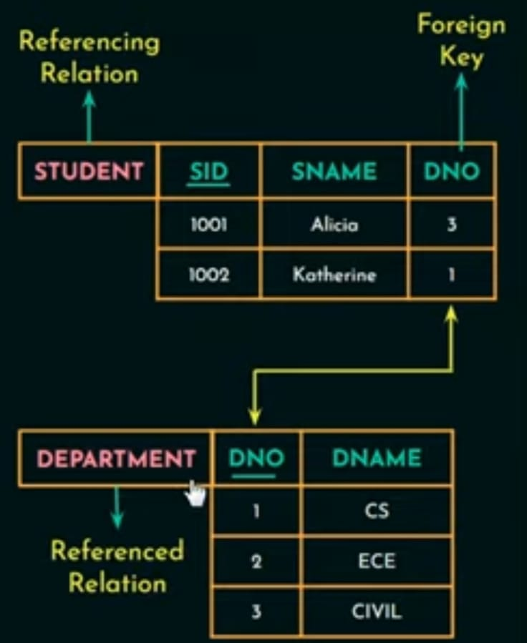
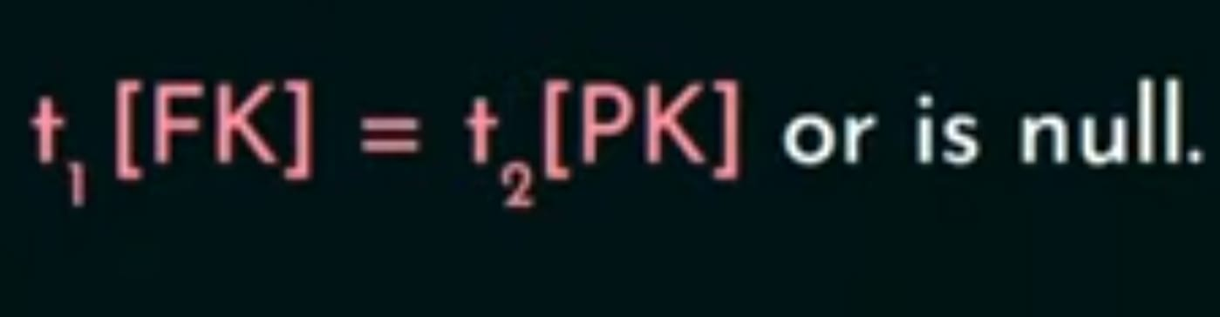
The attribute of one relation that refers to the primary key of another relation is called the foreign key.
Foreign key must satisfy the following:
1)It has to be a same domain as the attributes it refer to.
2)Value of foreign key in a tuple either occurs as a value of Primary key i.e

Slide 38
The operations of the relational model can be categorized into retrievals and updates
There are three basic update operations that can change the states of relations in the database:
1. Insert - used to insert one or more new tuples in a relation
2. Delete- used to delete tuples
3. Update (or Modify)- used to change the values of some attributes in existing tuples.

Slide 39
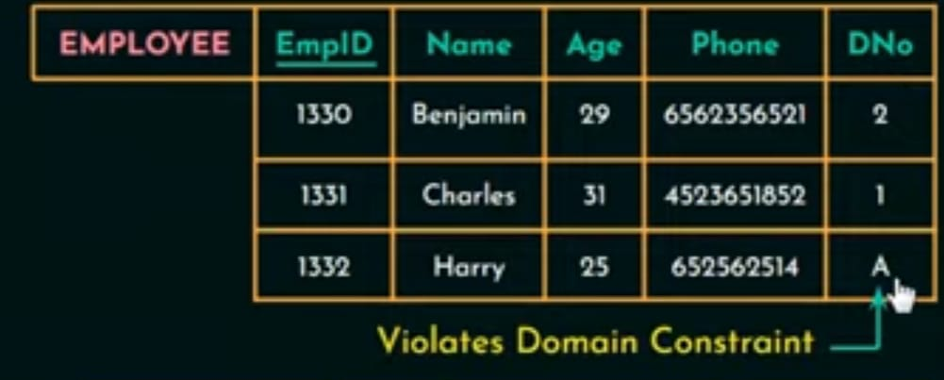
Update operation
The INSERT operation:
This operation is used to insert or add a new tuple in a relation.
Operation INSERT can violate four constraint.
Domain constraints : if an attribute value is given that does not appear in the corresponding domain or is not of the appropriate data type.
If INSERT operation violate any of the constraint then the default option is to rejected the insertion.

Slide 40
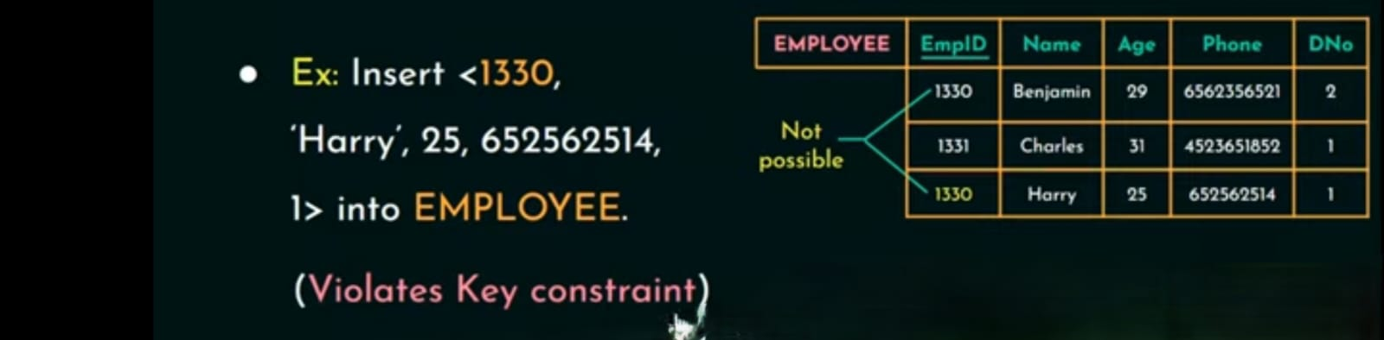
Key constraints : if a key value in the new tuple t already exists in another tuple in the relation r(R).

Slide 41
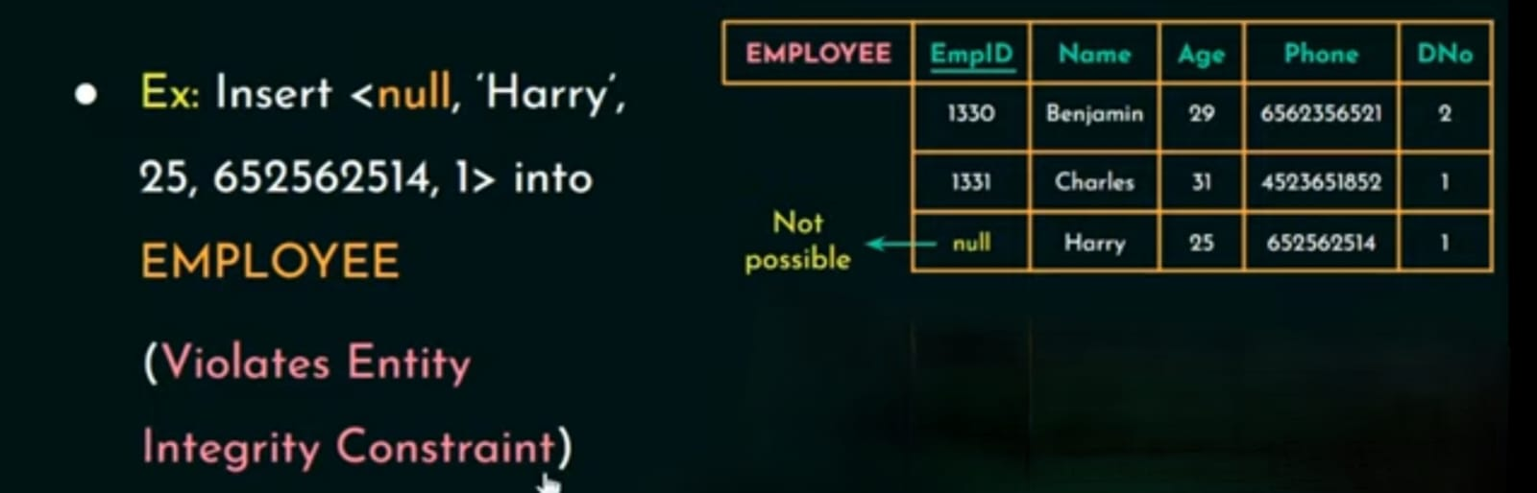
Entity integrity: if any part of the primary key of the new tuple t is NULL

Slide 42
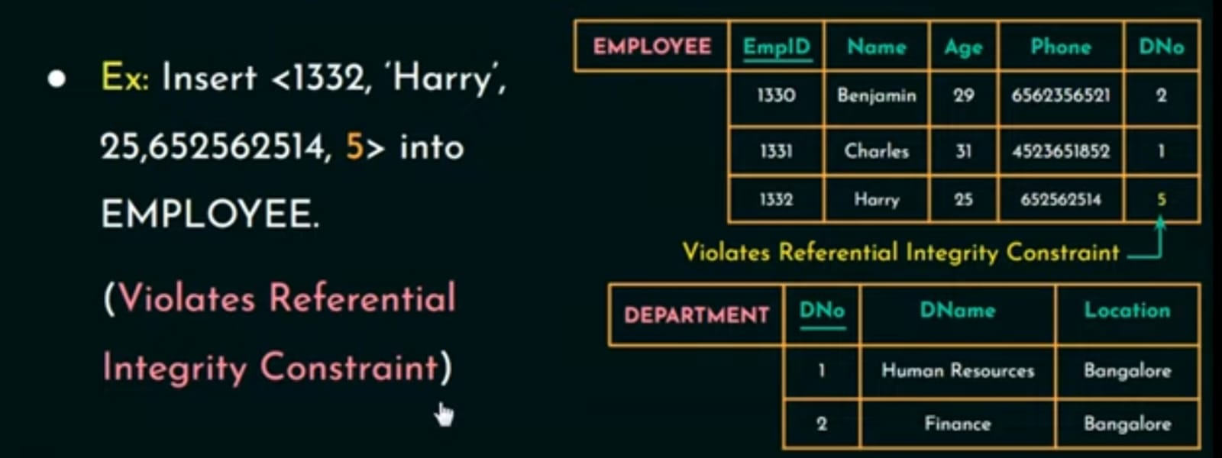
Referential integrity : if the value of any foreign key in t refers to a tuple that does not exist in the referenced relation.

Slide 43
DELETE Operation
The Delete operation can violate only referential integrity.
This occurs if the tuple being deleted is referenced by foreign keys from other tuples in the database.
To specify deletion, a condition on the attributes of the relation selects the tuple (or tuples) to be deleted.

Slide 44
If delete operation violate this constraint different action can be taken:
1. To reject the deletion.
2. To propagate or cascade the deletion.(that is when any tuple has to be deleted we also delete the tuples that refer this tuple).
3. Set null or set default - is to modify the referencing attribute values that cause the violation; each such value is either set to NULL or changed to reference another default valid tuple.

Slide 45
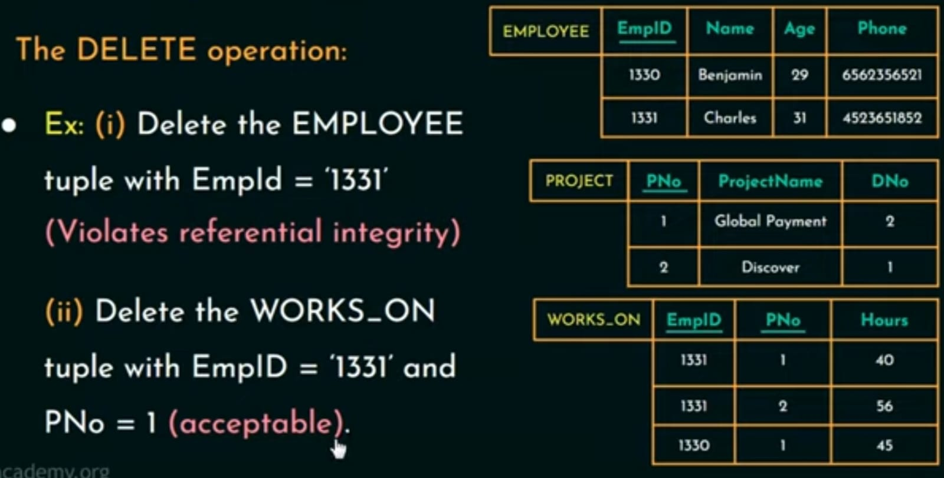

Slide 46
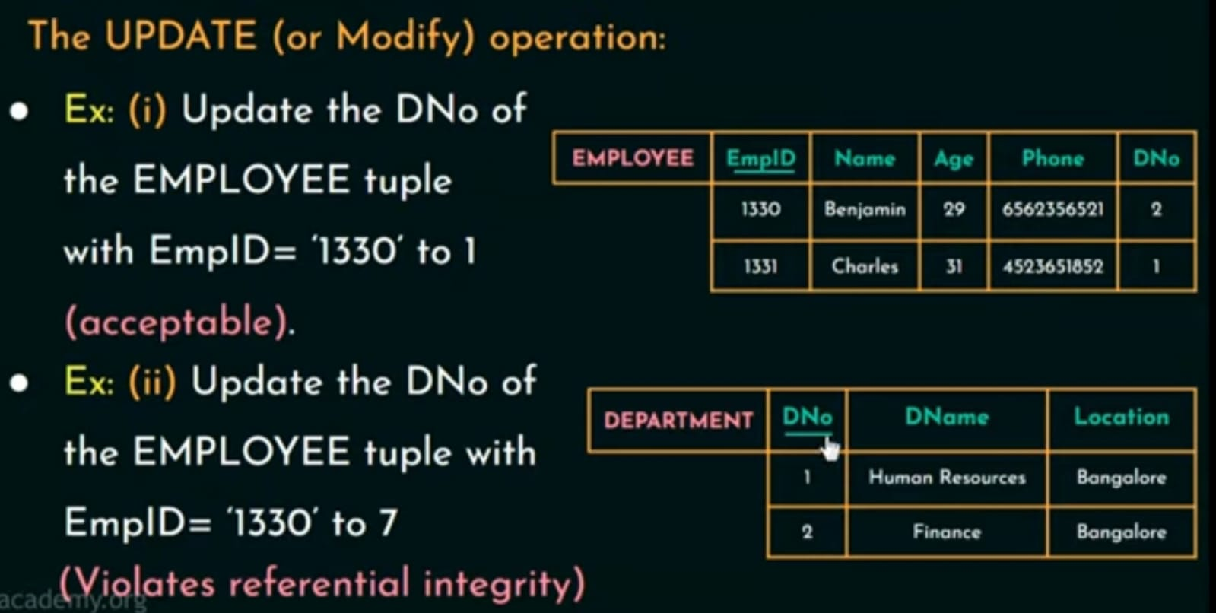
The UPDATE (or modify) Operation
This operation is used to update or modify the existing values of one or more attributes in a tuple of a relation.
If UPDATE operation violate constraints either reject the updation or we add a new tuple in this relation

Slide 47
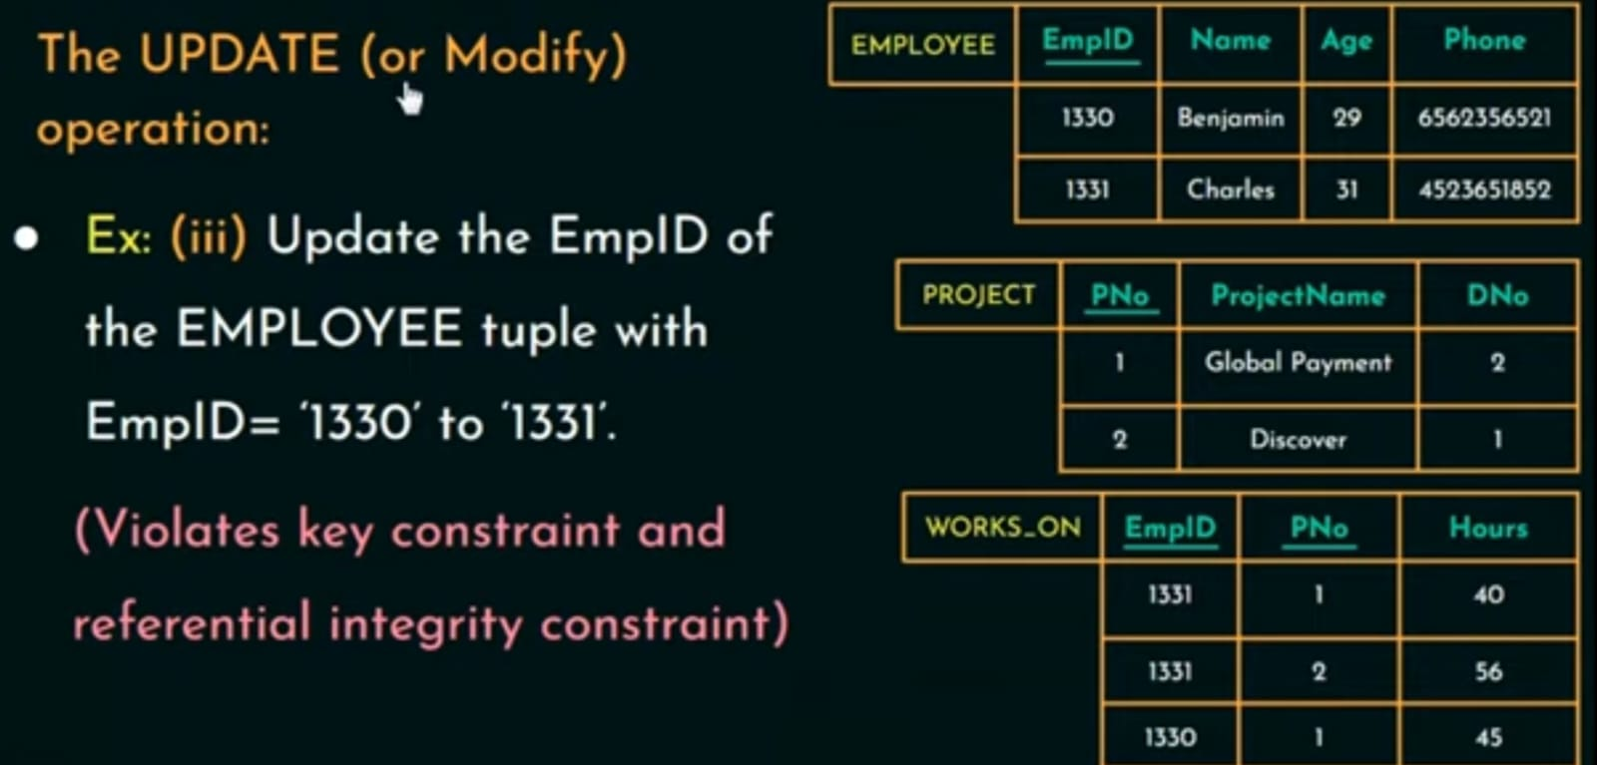

Slide 48
Chapter-2
Relational Algebra

Slide 49
Relation model has two formal languages one in the relational algebra and other in the relational calculus.
In this chapter we are going to learn about relational algebra.
Apart from constraints we required set of operation to manipulate the databases and those set of operation for the relation data model is called the relational algebra.
These operation help us to retrieve data from the database.
Like algebra in mathematics takes number as input and gives number as output in same way relation algebra takes relation as input and give relation as output.

Slide 50
Relational algebra, a procedural query language, forms the theoretical foundation of relational databases and SQL, providing a way to manipulate data through a set of operations, which are implemented by the DBMS query optimizer and executed on the database server.
Unary Relational Operations –Unary it means one or single
In mathematics unary operation is that operation that works with only one operand or only one input similarly unary relation operation works with only one relation

Slide 51

Unary Relational Operations
The SELECTION Operation used to select or retrieve data from a relation that satisfies a particular selection condition.
R is a relation
Selection condition is a condition that you have to specify to select or retrieve a particular data from a relation

Slide 52
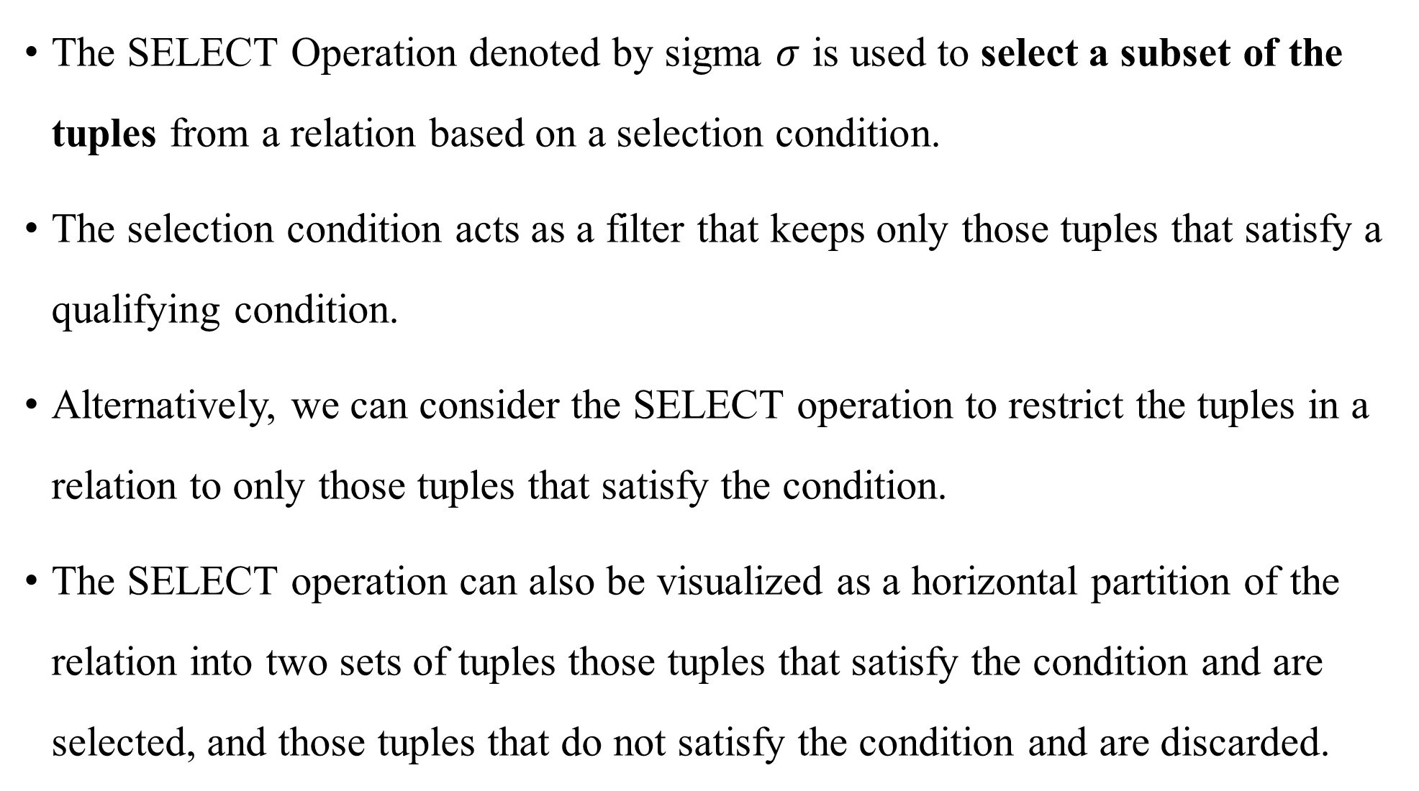
The SELECT Operation denoted by sigma $σ$ is used to select a subset of the tuples from a relation based on a selection condition.
The selection condition acts as a filter that keeps only those tuples that satisfy a qualifying condition.
Alternatively, we can consider the SELECT operation to restrict the tuples in a relation to only those tuples that satisfy the condition.
The SELECT operation can also be visualized as a horizontal partition of the relation into two sets of tuples those tuples that satisfy the condition and are selected, and those tuples that do not satisfy the condition and are discarded.

Slide 53
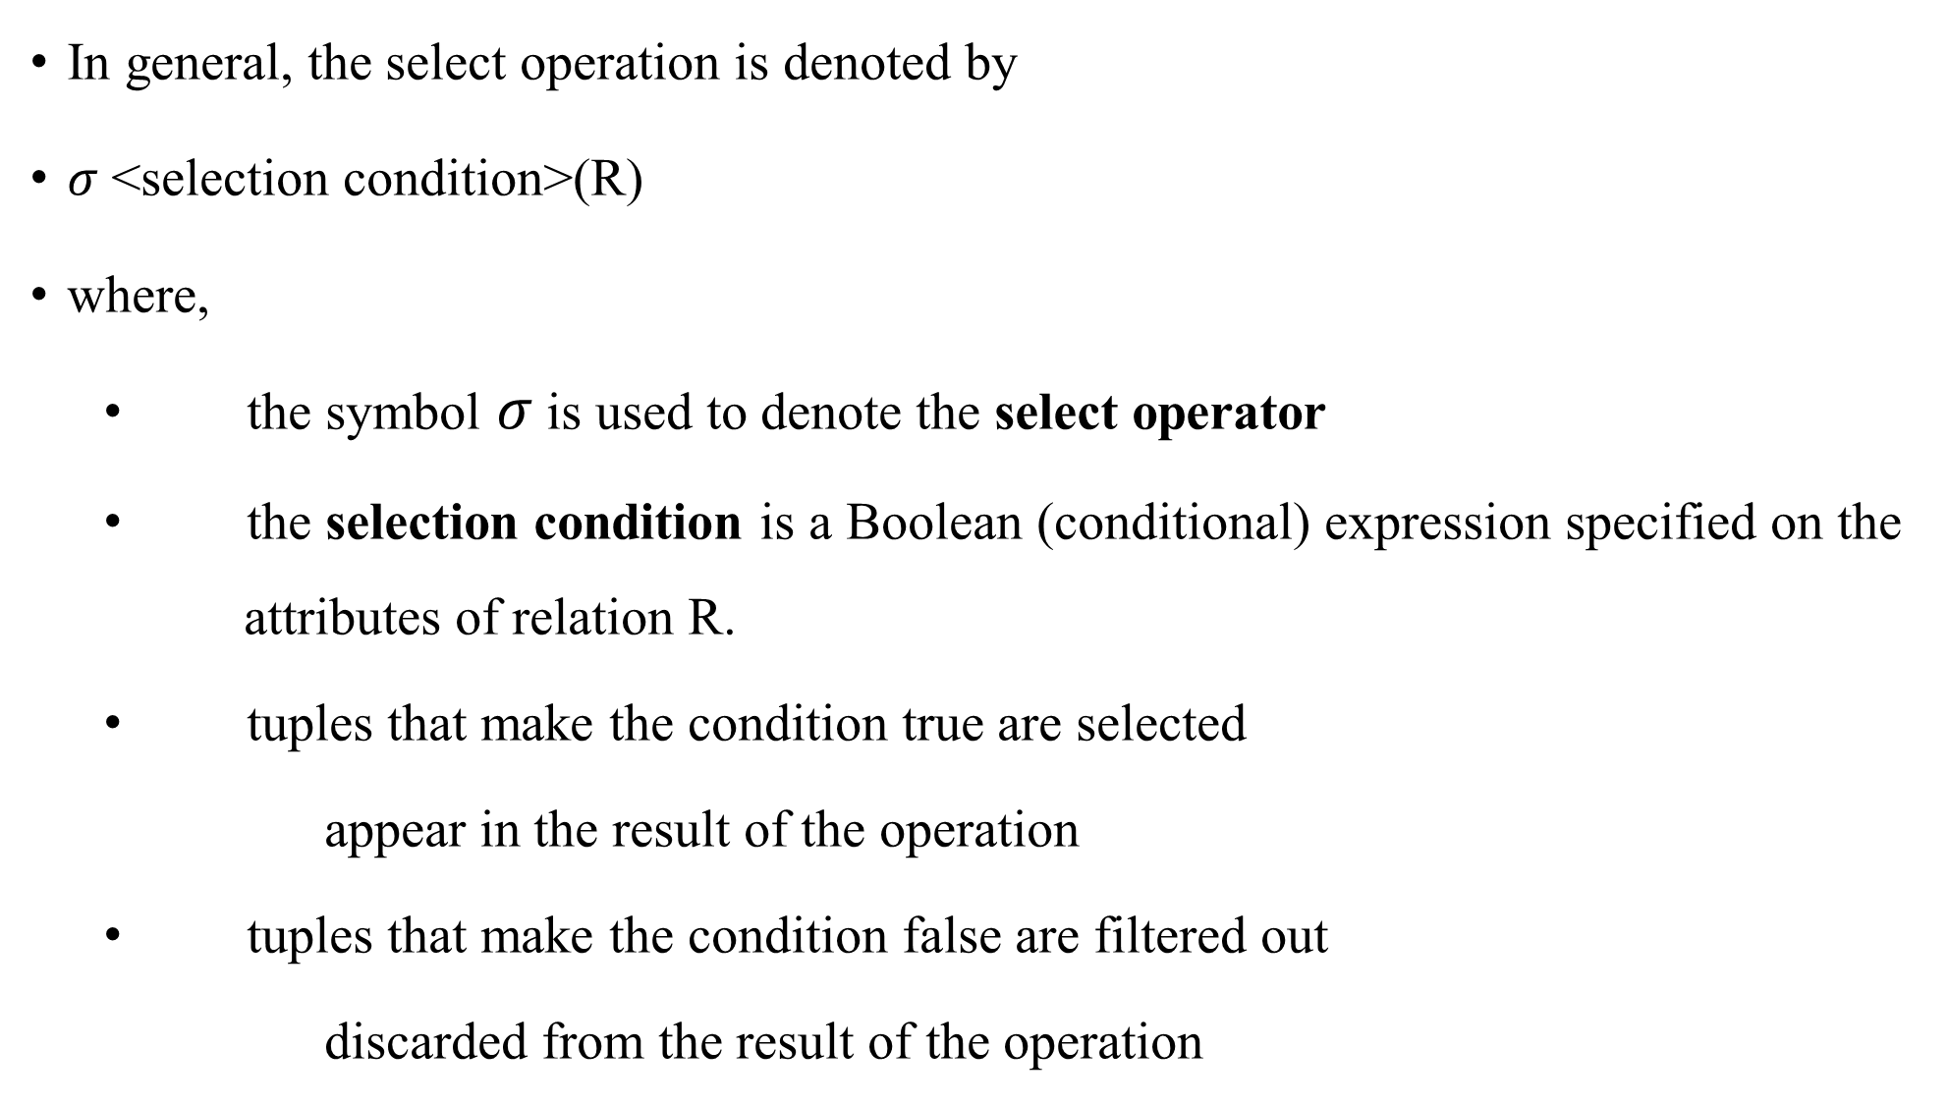
In general, the select operation is denoted by
$σ$<selection condition>(R)
where,
the symbol $σ$ is used to denote the select operator
the selection condition is a Boolean (conditional) expression specified on the attributes of relation R.
tuples that make the condition true are selected
appear in the result of the operation
tuples that make the condition false are filtered out
discarded from the result of the operation

Slide 54
The Boolean expression specified in <selection condition> is made up of a number of clauses of the form:
<attribute name> <comparison op> <constant value>
or
<attribute name> <comparison op> <attribute name>
where
<attribute name> is the name of an attribute of R,
<constant value> is a constant value from the attribute domain
Clauses can be connected by the standard Boolean operators and, or, and not to form a general selection condition

Slide 55
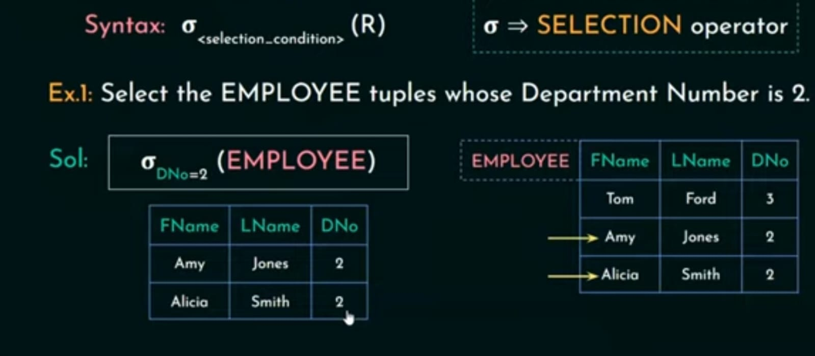
Selection condition here is a Boolean expression which is of the form attribute name followed by a comparison operator which could be either equal to or less than equal to , greater than equal to or not equal to and then followed by a constant value or it could also be another attribute name instead of this constant value.

Slide 56
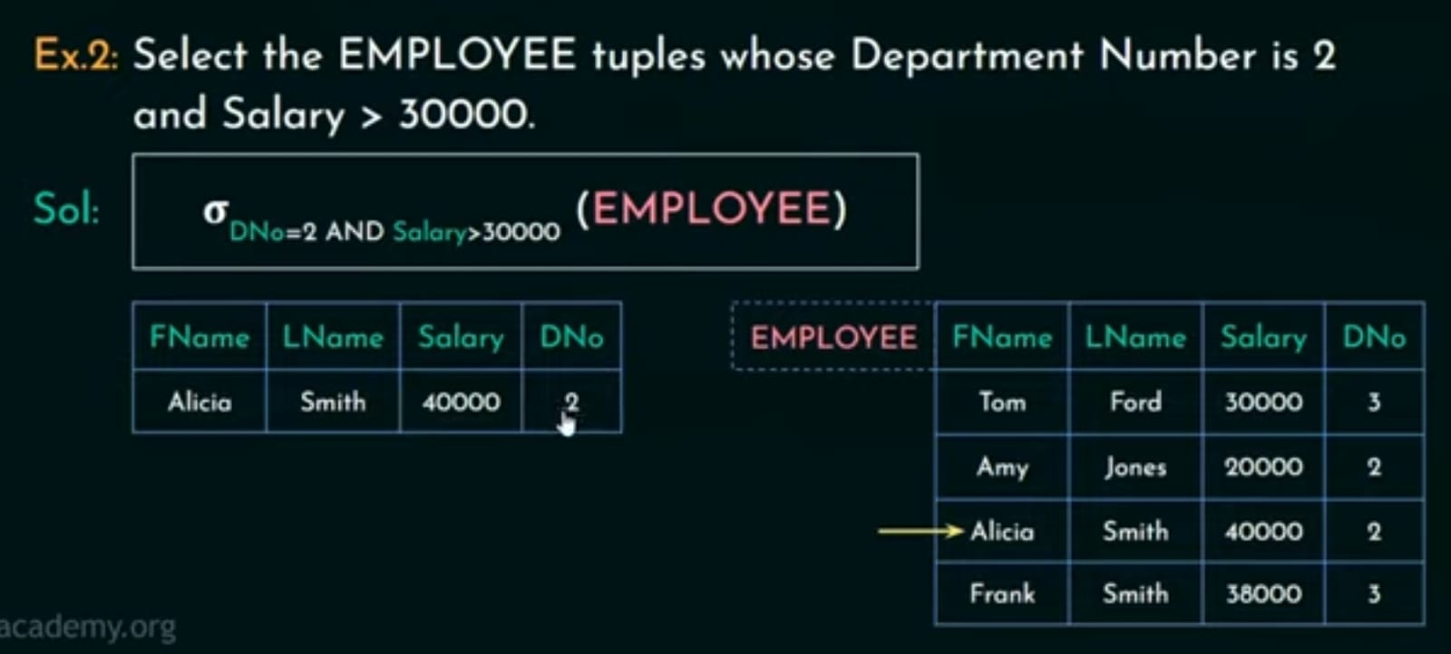
Here both the condition should be satisfy so we are using Boolean operator AND.

Slide 57
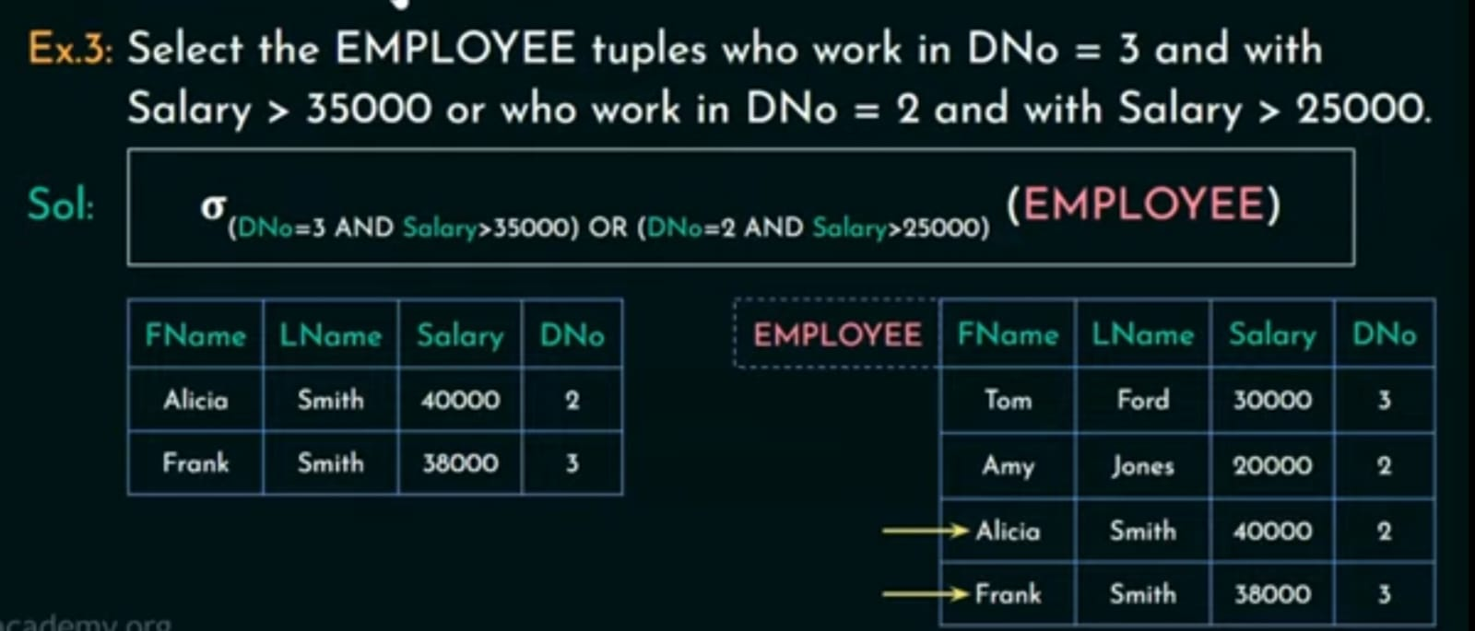

Slide 58
The result of a SELECT operation can be determined as follows:
The <selection condition> is applied independently to each individual tuple t in R
If the condition evaluates to TRUE, then tuple t is selected.
All the selected tuples appear in the result of the SELECT operation
The Boolean conditions AND, OR, and NOT have their normal interpretation, as follows:
(cond1 AND cond2) is TRUE if both (cond1) and (cond2) are TRUE;
otherwise, it is FALSE.
(cond1 OR cond2) is TRUE if either (cond1) or (cond2) or both are TRUE;
otherwise, it is FALSE.
(NOT cond) is TRUE if cond is FALSE; otherwise, it is FALSE.

Slide 59
The SELECT operation is commutative; that is,
<cond1> <cond2> <cond2> <cond1>(R))
Hence, a sequence of SELECTs can be applied in any order.
we can always combine a cascade (or sequence) of SELECT operations into a single SELECT operation with a conjunctive (AND) condition; that is,
<cond1> <condn>(R <cond1> AND<cond2> AND ... AND <condn>(R)
In SQL, the SELECT condition is specified in the WHERE clause of a query.
Dno=4 AND Salary>25000 (EMPLOYEE) would to the following SQL query:
SELECT * FROM EMPLOYEE WHERE Dno=4 AND Salary>25000;

Slide 60
Selection operation are the horizontal partitioning of the table or the relation that is it divides the table or the relation horizontally into two sets of tuples one set of tuples are those tuples that satisfy the given condition and are selected and the other set of tuples are those tuples that do not satisfy the condition and are not selected

Slide 61

The Project Operation
Selection operation select the row or tuple of the relation whereas the projection operation select the column of the relation.
Pi is the projection operation
Attribute list that you want to display which is written as subscript followed by the relation name.

Slide 62
The PROJECT operation denoted by selects certain columns from the table and discards the other columns
The result of the
PROJECT operation can be visualized as a vertical partition of the relation into two relations:
- one has the needed columns (attributes) and contains the result of the operation.
- the other contains the discarded columns.

Slide 63
The general form of the PROJECT operation is
∏<attribute list>(R)
where
-∏(pi) symbol used to represent the PROJECT operation,
<attribute list> - desired sub list of attributes from the attributes of relation R.
The result of the PROJECT operation has only the attributes specified in <attribute list> in the same order as they appear in the list.
Hence, its degree is equal to the number of attributes in <attribute list>

Slide 64
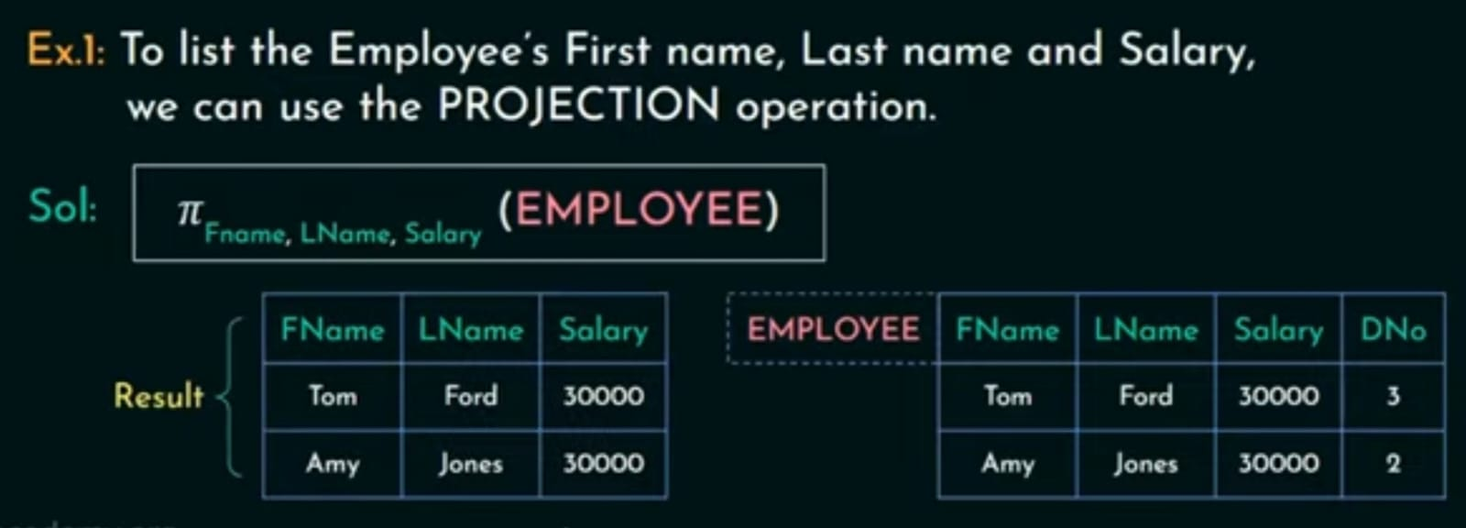
If we have two tuple with the exact same values , projection operation removes the duplicate tuples.

Slide 65
The number of tuples in a relation resulting from a PROJECT operation is always less than or equal to the number of tuples in R. Commutativity does not hold on PROJECT
<list1> <list2>(R <list1>(R)
as long as <list2> contains the attributes in <list1>; otherwise, the left-hand side is an incorrectexpression.
In SQL, the PROJECT attribute list is specified in the SELECT clause of a query. For example, the following operation:
gender, Salary(EMPLOYEE) would correspond to the following SQL query:
SELECT DISTINCT gender, Salary FROM EMPLOYEE

Slide 66
Selection operation is the horizontal partition of the relation or the table.
Whereas the projection operation is the vertical partitioning of the relation into two sets one set is the set of column that is to be displayed and the other set is a set of columns that has to be discarded or that need not be displayed

Slide 67

The RENAME Operation($ρ)$
Now there can be a situation where we have to apply several relational algebra operations in that case we can write it as a one single expression with all the relational algebra operations in that single expression or we can also divide the single expression by applying one operation at a time creating intermediate relations.

Slide 68
For retrieve the first name and the last name of all the employee working in department number 3 Should use both the selection and projection operator.
Selection operator used because there is a condition – where all the employees has to be working in department number 3.
Projection operator used because we specifically need only two attributes from this relation employee
Therefore we us both the selection and projection operator

Slide 69
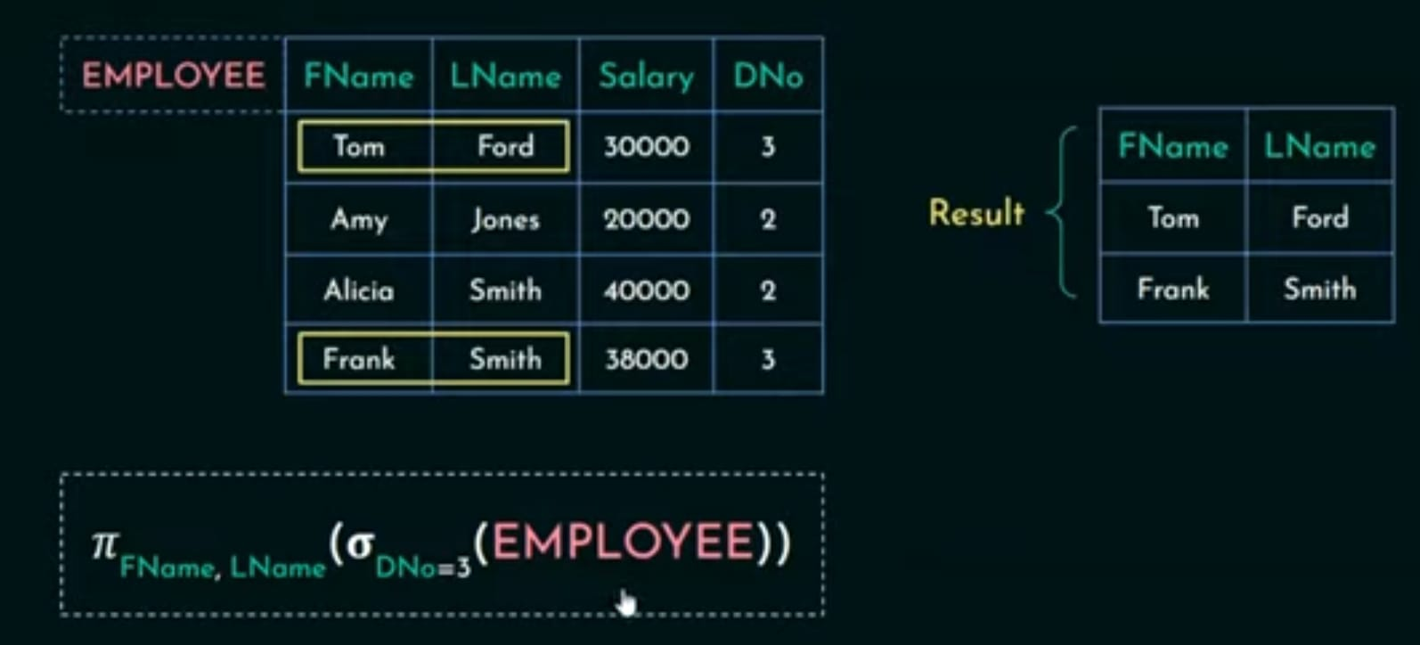

Slide 70
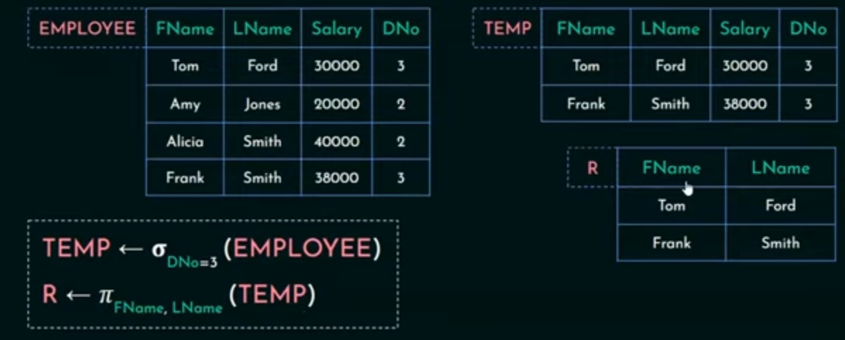

Slide 71
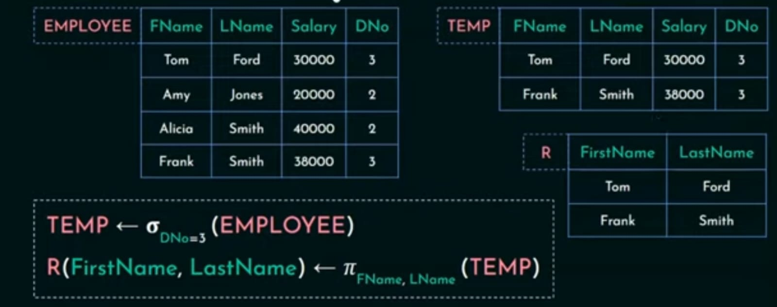

Slide 72
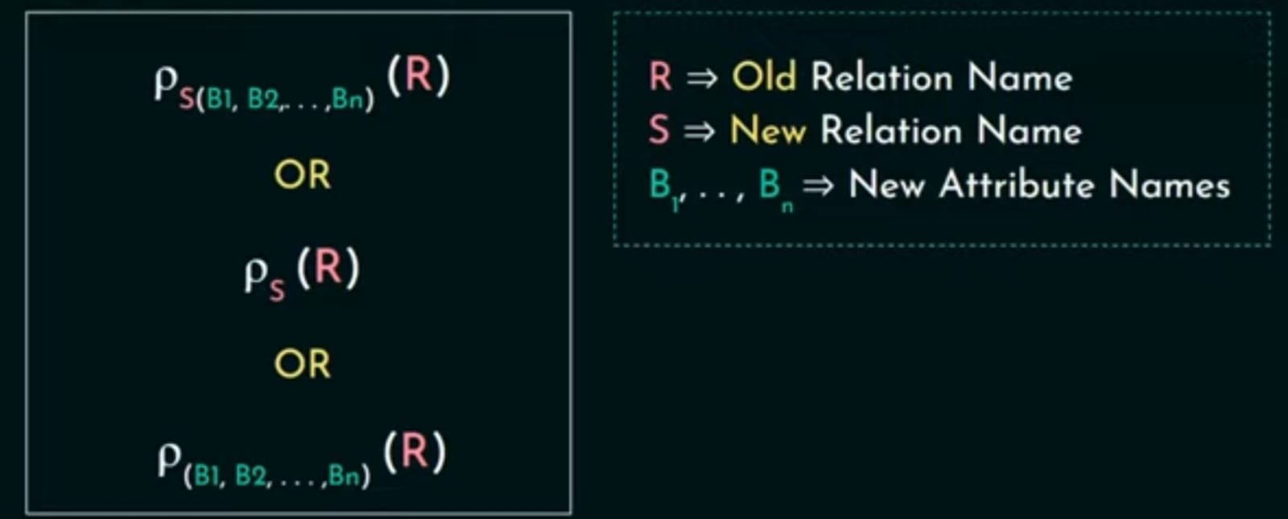

Slide 73
The first expression renames both the relation and its attributes.
Second renames the relation only.
The third renames the attributes only.
If the attributes of R are (A1, A2, ..., An) in that order, then each Ai is renamed as Bi.
Renaming in SQL is accomplished by aliasing using AS, as in the following example:
SELECT E.Fname AS First_name, E.Lname AS Last_name, E.Salary AS Salary FROM EMPLOYEE AS E WHERE E.Dno=5,

Slide 74
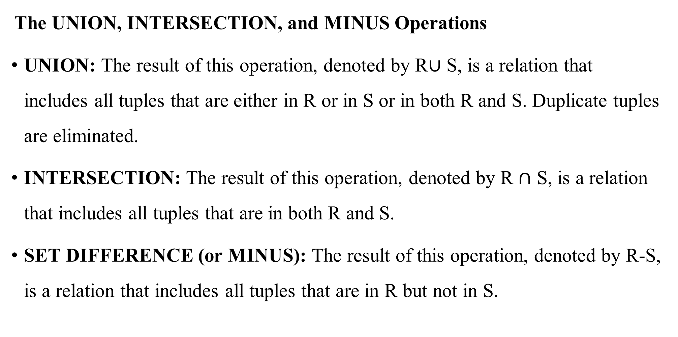
Relational Algebra Operations from Set Theory
The UNION, INTERSECTION, and MINUS Operations
UNION: The result of this operation, denoted by R$∪$ S, is a relation that includes all tuples that are either in R or in S or in both R and S. Duplicate tuples are eliminated.
INTERSECTION: The result of this operation, denoted by R $∩$ S, is a relation that includes all tuples that are in both R and S.
SET DIFFERENCE (or MINUS): The result of this operation, denoted by R-S, is a relation that includes all tuples that are in R but not in S.

Slide 75
Union ,Intersection and set difference or the minus operation the two relations on which any of these three operations are applied must be union compatible or type compatible.
Two relations are said to be union compatible if they have the same degree or the same number of attributes and also if they have same attribute domains.

Slide 76
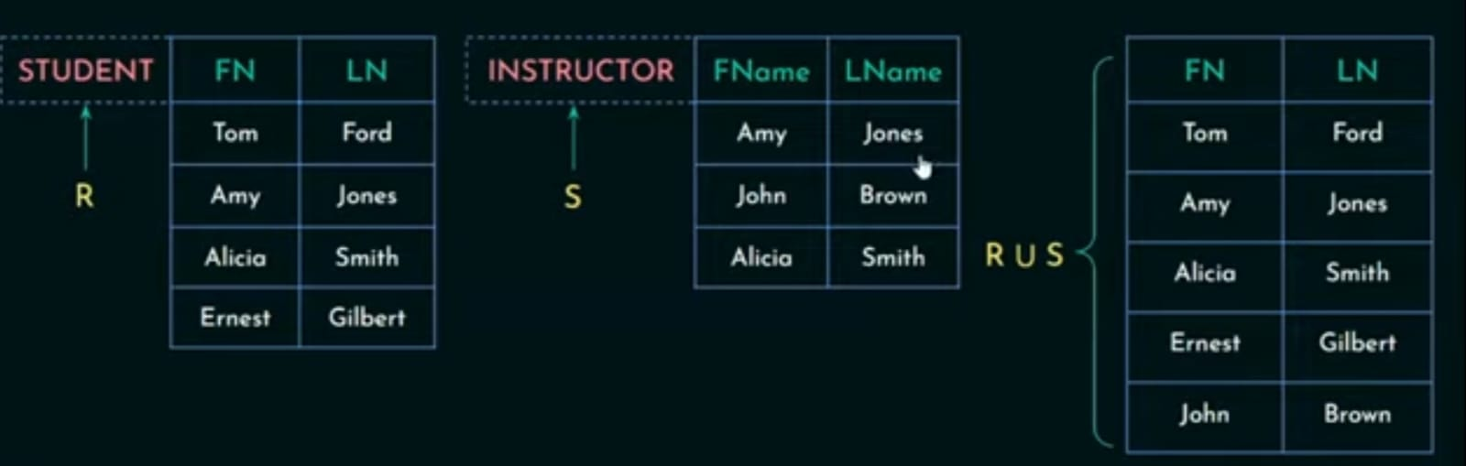

The UNION Operation(R $∪$S)
Union of two relation would be a relation that includes all tuples that are either in R or in S or in both R and S.

Slide 77
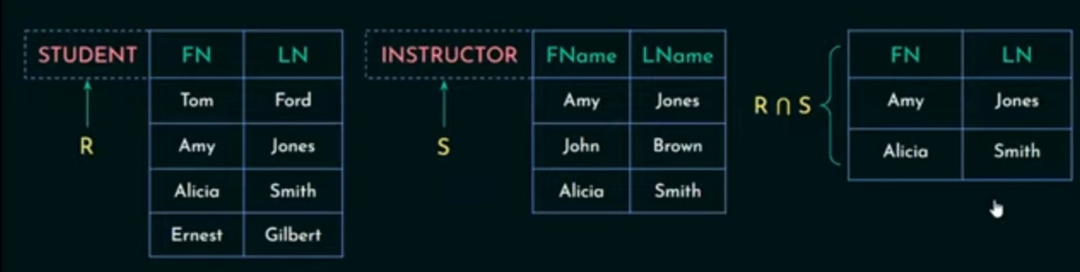

The Intersection Operation(R $∩$ S)
Intersection of two relation would be a relation that includes all tuples that are in both R and S.

Slide 78
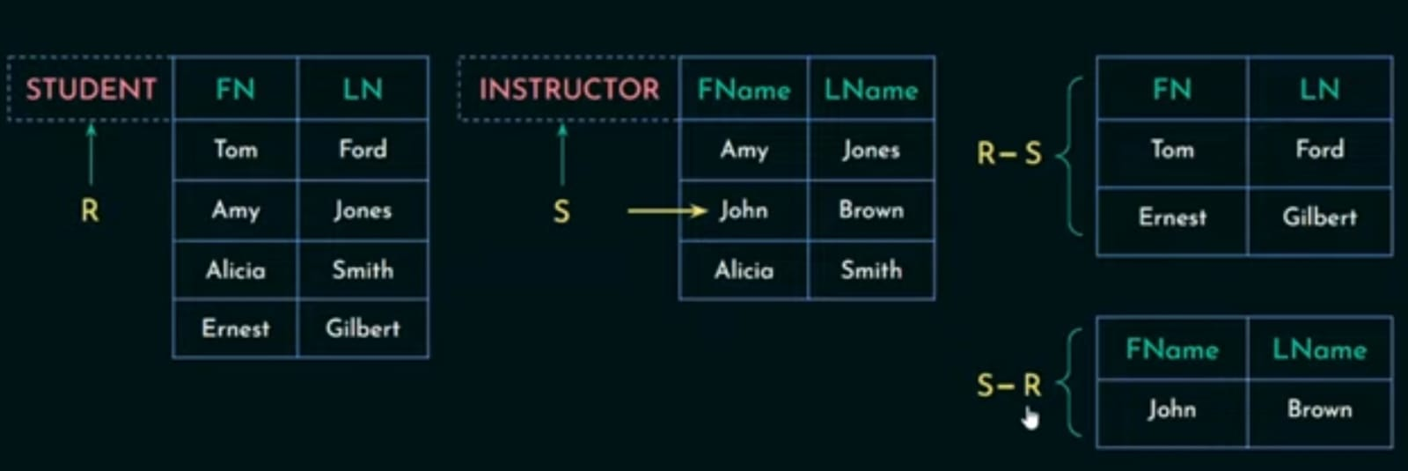
The MINUS Operation (R-S)
Includes all tuples that are in R but not in S.

Slide 79
The CARTESIAN PRODUCT Operation (R × S)
Cartesian product operation or cross product operation or cross join operation denoted as R cross S.
Cartesian product of relation would result in a relation that would have the combined attributes of two relations that we have join.
Generally this operation is used when we want to join two tables or two relations.

Slide 80
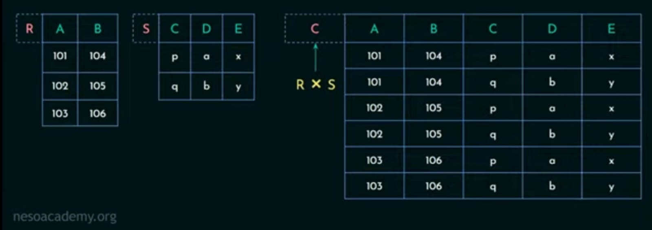

Slide 81
If relation R is of degree p and relation S is of degree n then the final relation on the resulting relation will be of the degree p + n that is the sum of both the degrees.
So this relation R is of degree 2 since it has two attributes and this relation S is of degree 3 since it has three attributes so the degree of the result R cross S will be 2 plus 3 that is 5.
The cardinality of R is 3 and cardinality of S is 2.
Hence the cardinality of R × S is 6
The resulting relation will be having 6 tuples

